Slide 1

EAL at Cotteridge Primary School

Slide 2
EAL Provision at Cotteridge Primary School
At Cotteridge Primary School, we are incredibly proud of our diverse community, with over 30 different home languages spoken by our families. We use the Birmingham Ordinarily Available Guidance (OAG) as our framework for assessing and supporting all our EAL learners, ensuring a consistent and evidence-based approach to meeting their needs.
Our teachers adapt their teaching to provide appropriate scaffolding and visual supports, enabling EAL pupils to access the curriculum and engage with learning alongside their peers. This includes the use of visual aids, graphic vocabulary banks, and modelled examples to support language development and comprehension across all curriculum areas.
We actively celebrate and embrace the linguistic and cultural diversity within our school through initiatives such as our annual Diversity Week, 'Bring a Dish' events where families share food from their home cultures, and regular parent coffee mornings that provide support and build strong relationships with our families.
We recognise that our EAL pupils' home languages and cultural backgrounds are valuable assets, and we work to ensure that all families feel welcomed, valued, and included in our school community.

Slide 3
What is the OAG?
What is the OAG?
The Birmingham OAG is a graduated response framework that describes the support that should be "ordinarily available" to all pupils in Birmingham schools. It's designed to help schools provide appropriate support at different levels of need across the whole school population.
The framework typically works on a tiered approach:
Universal provision - high-quality teaching and support for all pupils
Targeted provision - additional support for pupils who need it (this could include EAL learners, pupils falling behind, or those with emerging needs)
Specialist provision - more intensive support for pupils with significant needs

Slide 4
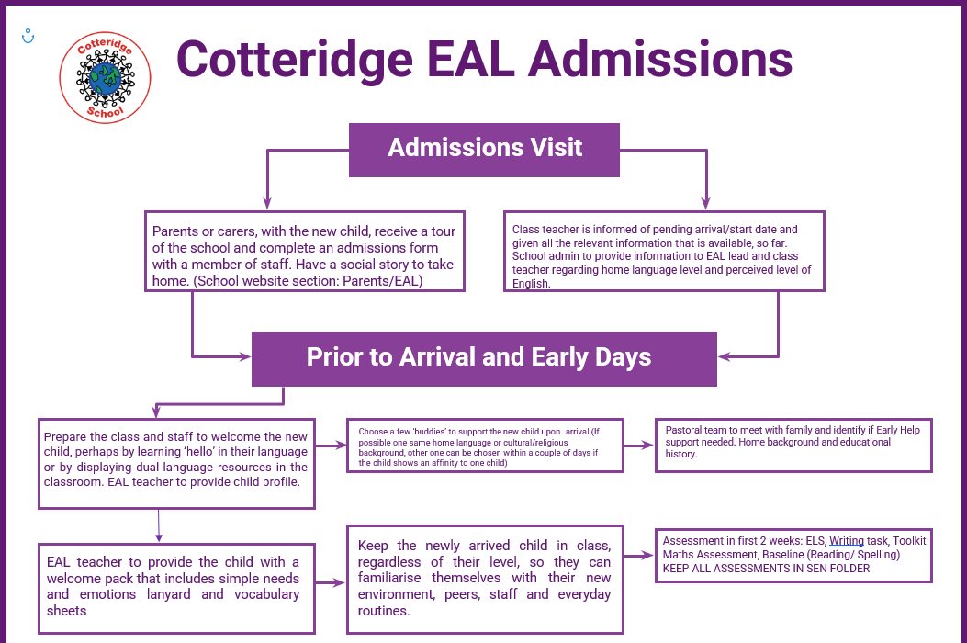

Slide 5
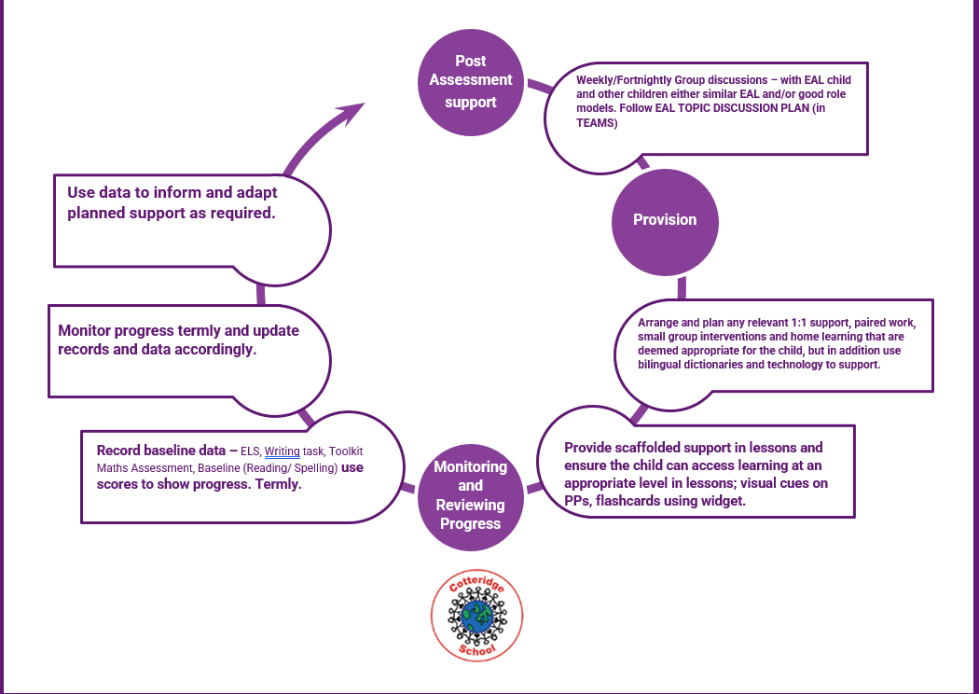

Slide 6

How we support our EAL pupils at Cotteridge

Slide 7
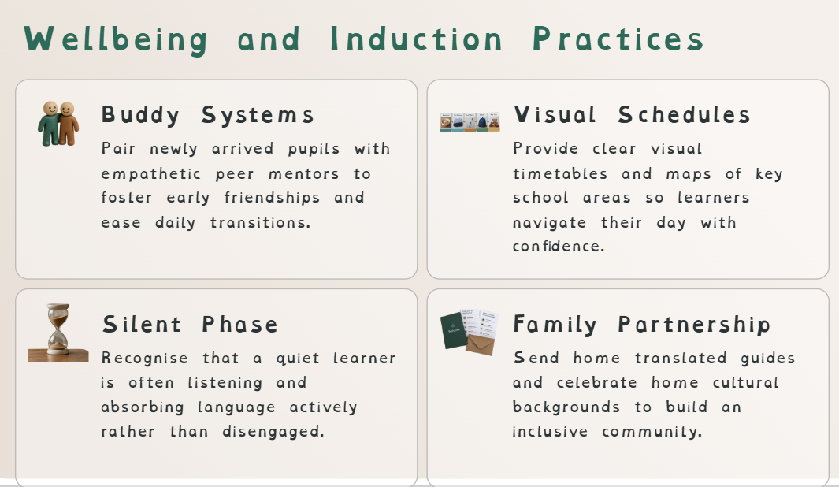

Slide 8
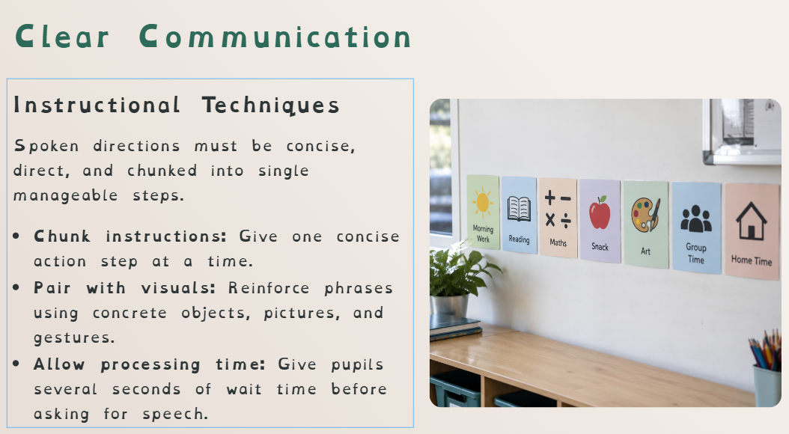

Slide 9
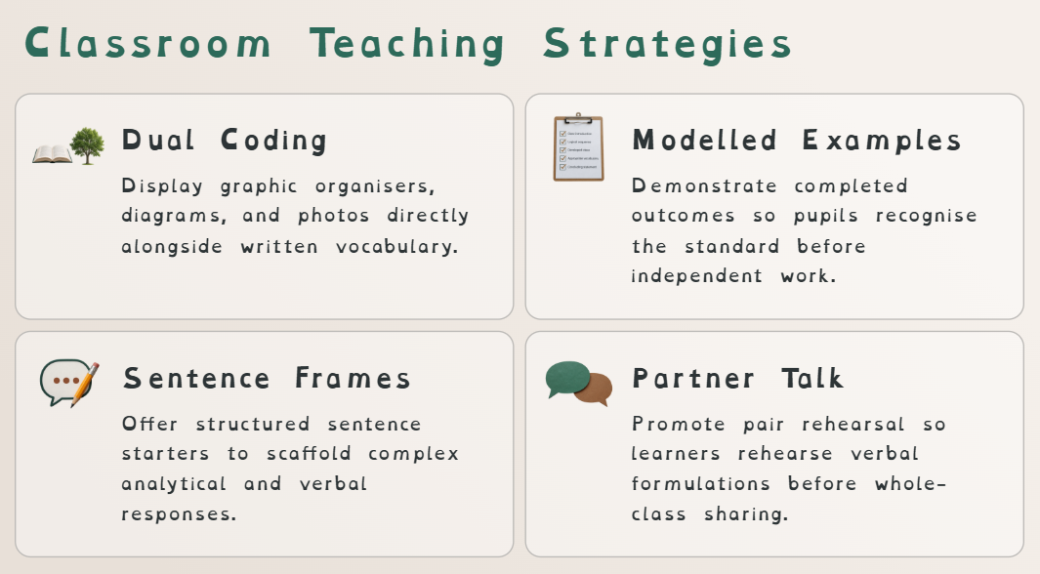

Slide 10
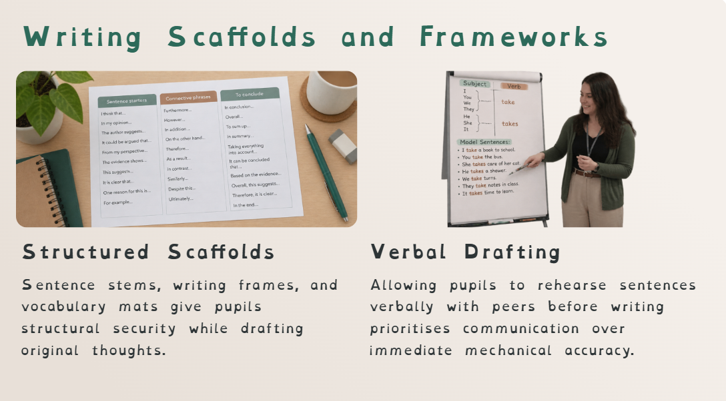

Slide 11
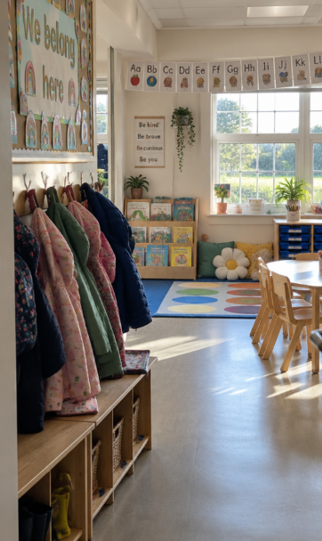
Supporting Your Child in School
Academic success begins with emotional security. When children feel grounded at home, they adapt to unfamiliar classrooms with greater resilience.

Slide 12
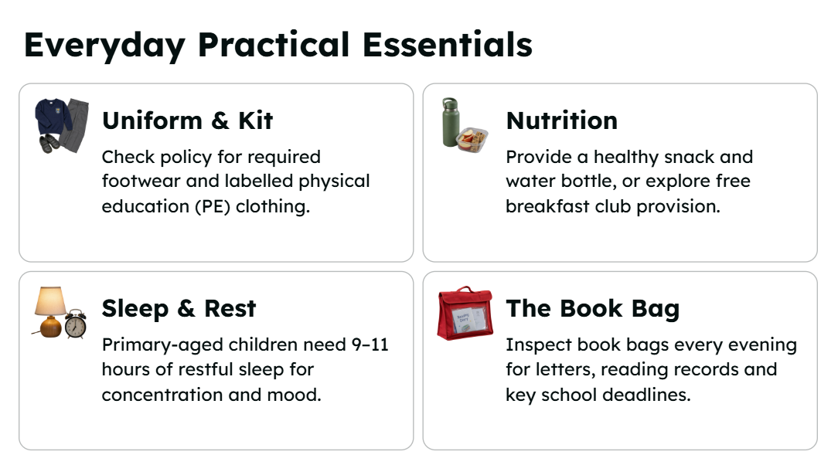

Slide 13


Slide 14


Slide 15
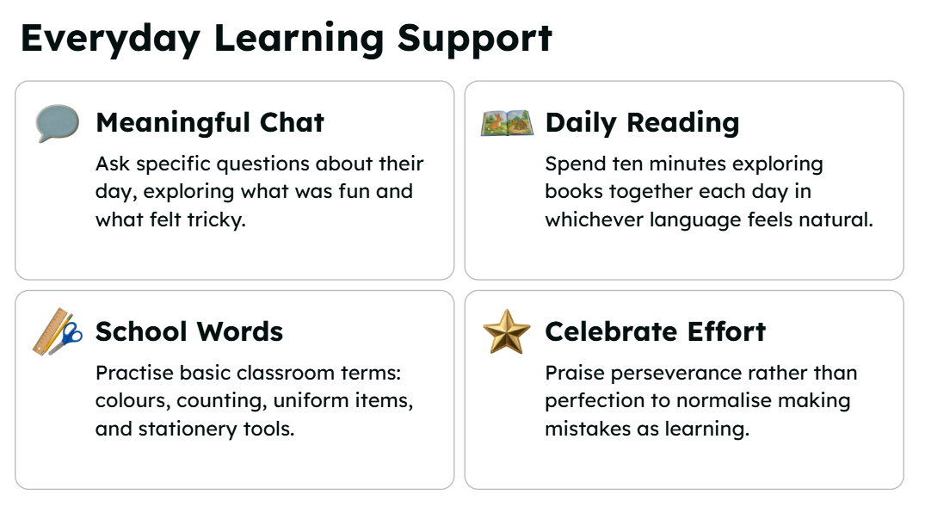

Slide 16
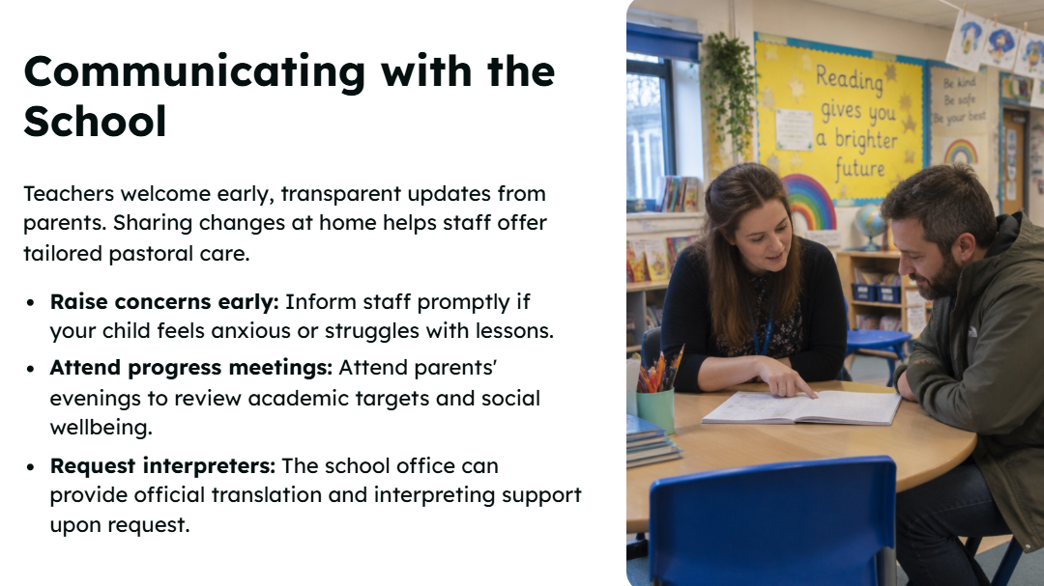

Slide 17
Thank you!

